Slide 1

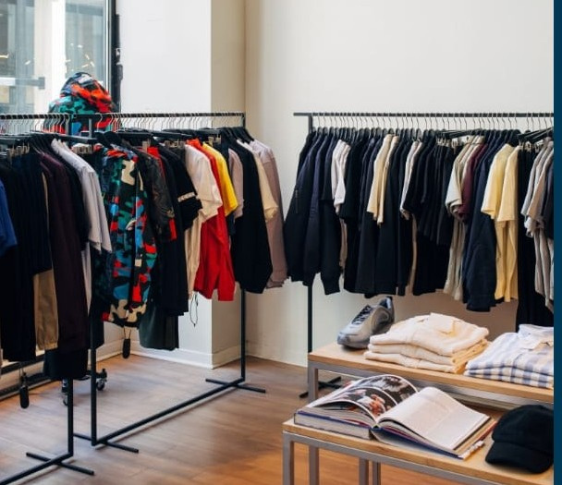

SAWARIYA
FUTUREWORKS
VRO
your styling buddy
Presented by: Riya Shukla

Slide 2
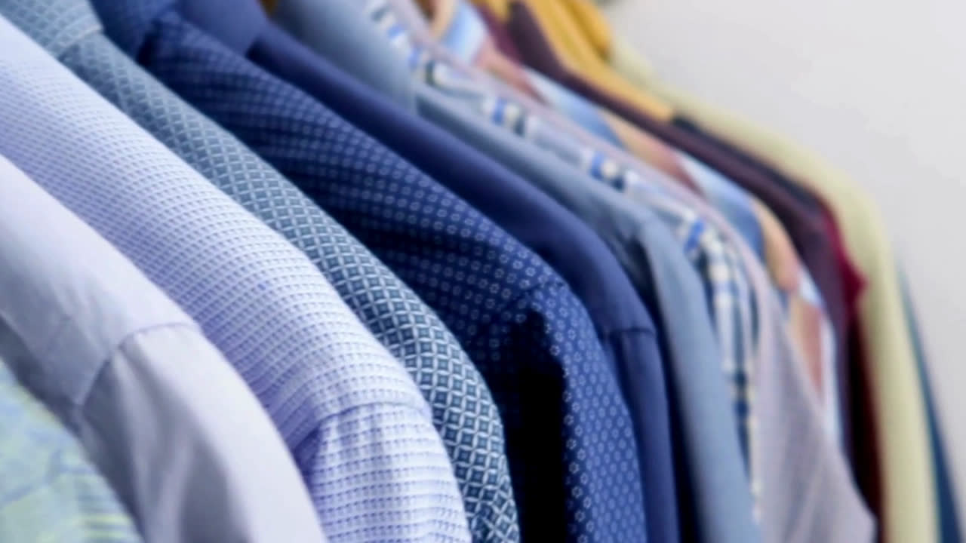


Introduction
This presentation showcases two AI projects. Both of them are focused on
transforming the way men approach shopping and styling.
The first project is an AI Avatar built for the VRO app, which acts as a personal styling guide. The second is an AI Agent Prototype, designed to make shopping more interactive and personalized.
The goal was to make styling easier, more fun, and more personal through an avatar that feels like a real fashion assistant.

Slide 3


Project 1: AI Avatar – VRO Styling App
The first project is called the AI Avatar for VRO App.
The problem I wanted to address is that many men find it challenging to make styling decisions or choose outfits that reflect their personality. Shopping apps usually provide catalogs but lack personalized interaction.
My solution was to create an AI-powered avatar that can interact with users directly. The goal was to make styling easier, more fun, and more personal through an avatar that feels like a real fashion assistant.

Slide 4

Features
The AI Avatar comes with several unique features.
It is designed to talk and interact with users naturally, almost like speaking with a real stylist.
Users can communicate with the avatar in three ways: by speaking to it, typing their queries, or even through simple gestures.
Based on these inputs,
the avatar provides
styling suggestions
customized to the individual’s
needs and preferences.
To make it widely accessible, the avatar is capable of conversing in both English and Hindi, so it appeals to a larger audience.

Slide 5


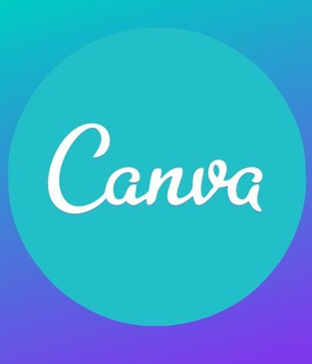

Tools & Technologies
The prototype also included basic integration with styling recommendations, so the avatar could suggest looks and outfits from the VRO app.
HeyGen – I used HeyGen to generate the AI video of the avatar. This gave the avatar realistic facial expressions and lip-sync so it could actually “talk” like a human.
Leonardo AI – I used Leonardo AI for generating the avatar’s base images. These images gave the avatar a unique look and personality before turning it into a talking character.
Eleven Labs – I used Eleven Labs to convert text into natural-sounding speech. This allowed the avatar to speak fluently, making the experience more engaging and life-like.
Canva – Finally, I used Canva to edit and compile the avatar video. Here I gave users the option to select between either Hindi or English as their preferred language, making the avatar more inclusive and accessible.

Slide 6
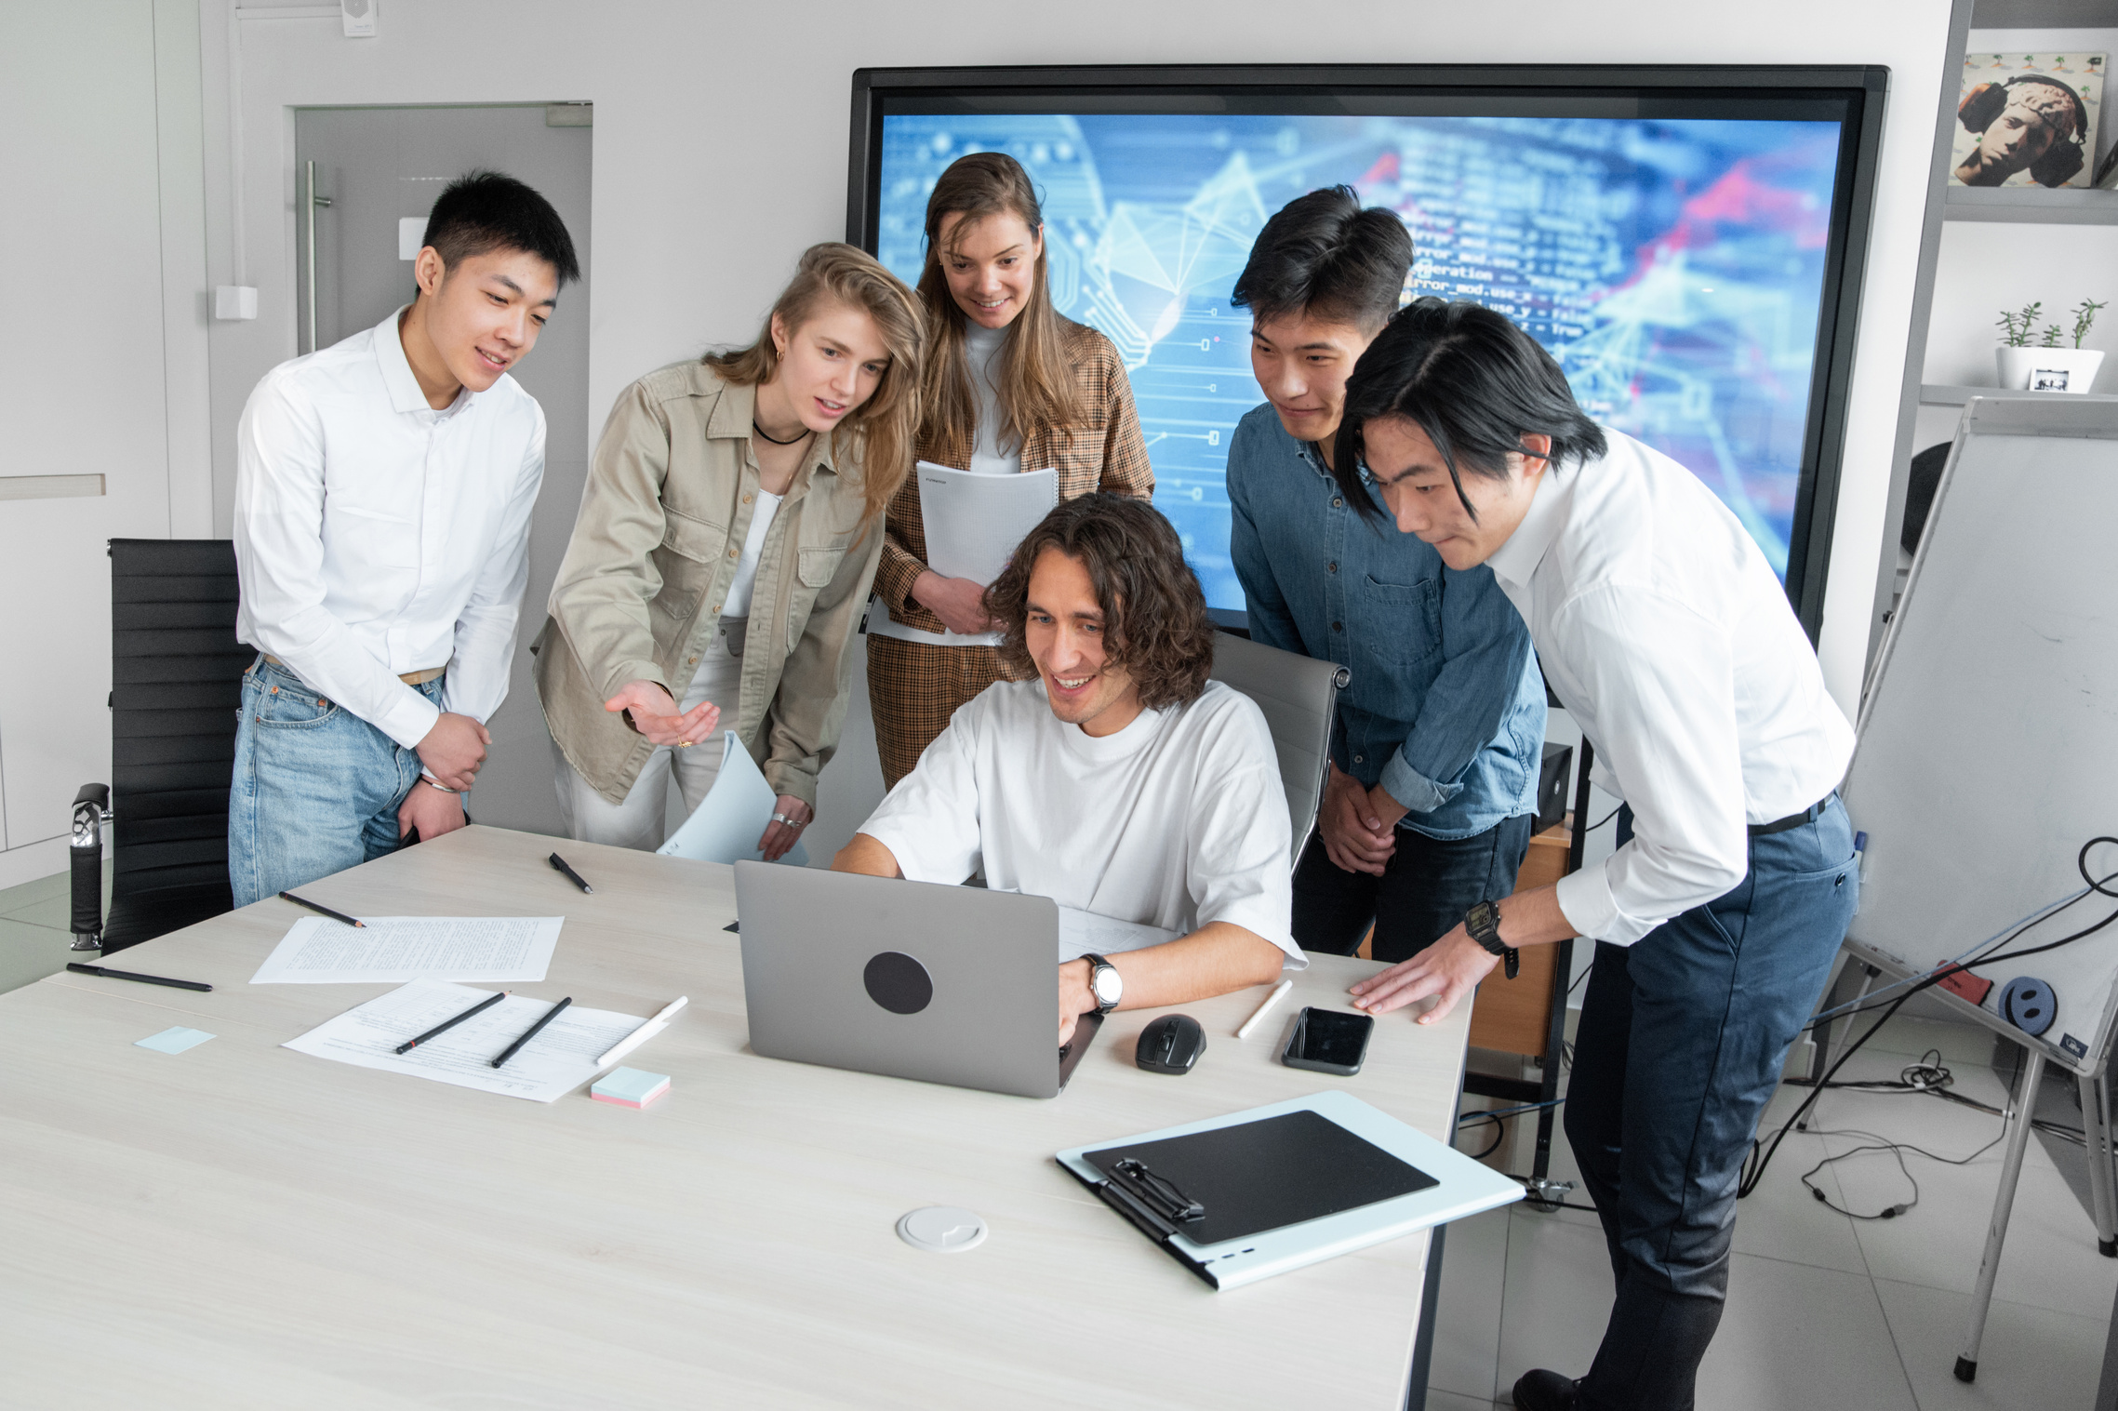
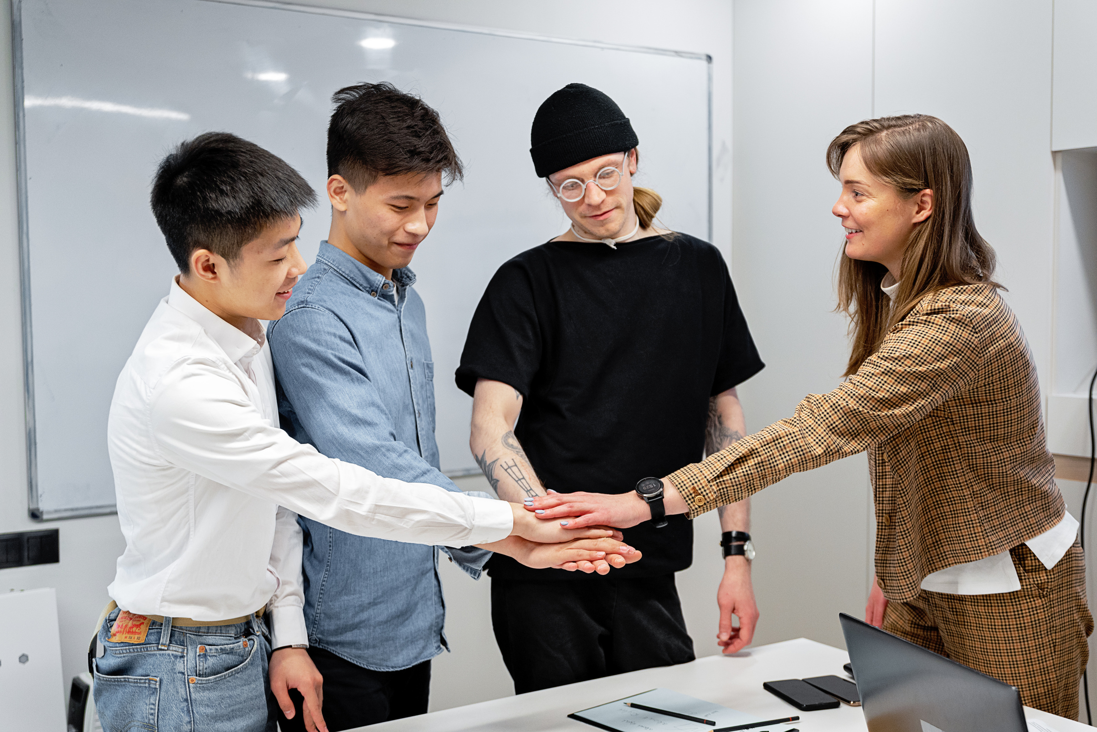
Demo Link
You can view this project directly using the following link:
🔗 AI Avatar (VRO App) Prototype
This demo gives you a clear picture of how the avatar looks, behaves, and interacts.

Slide 7
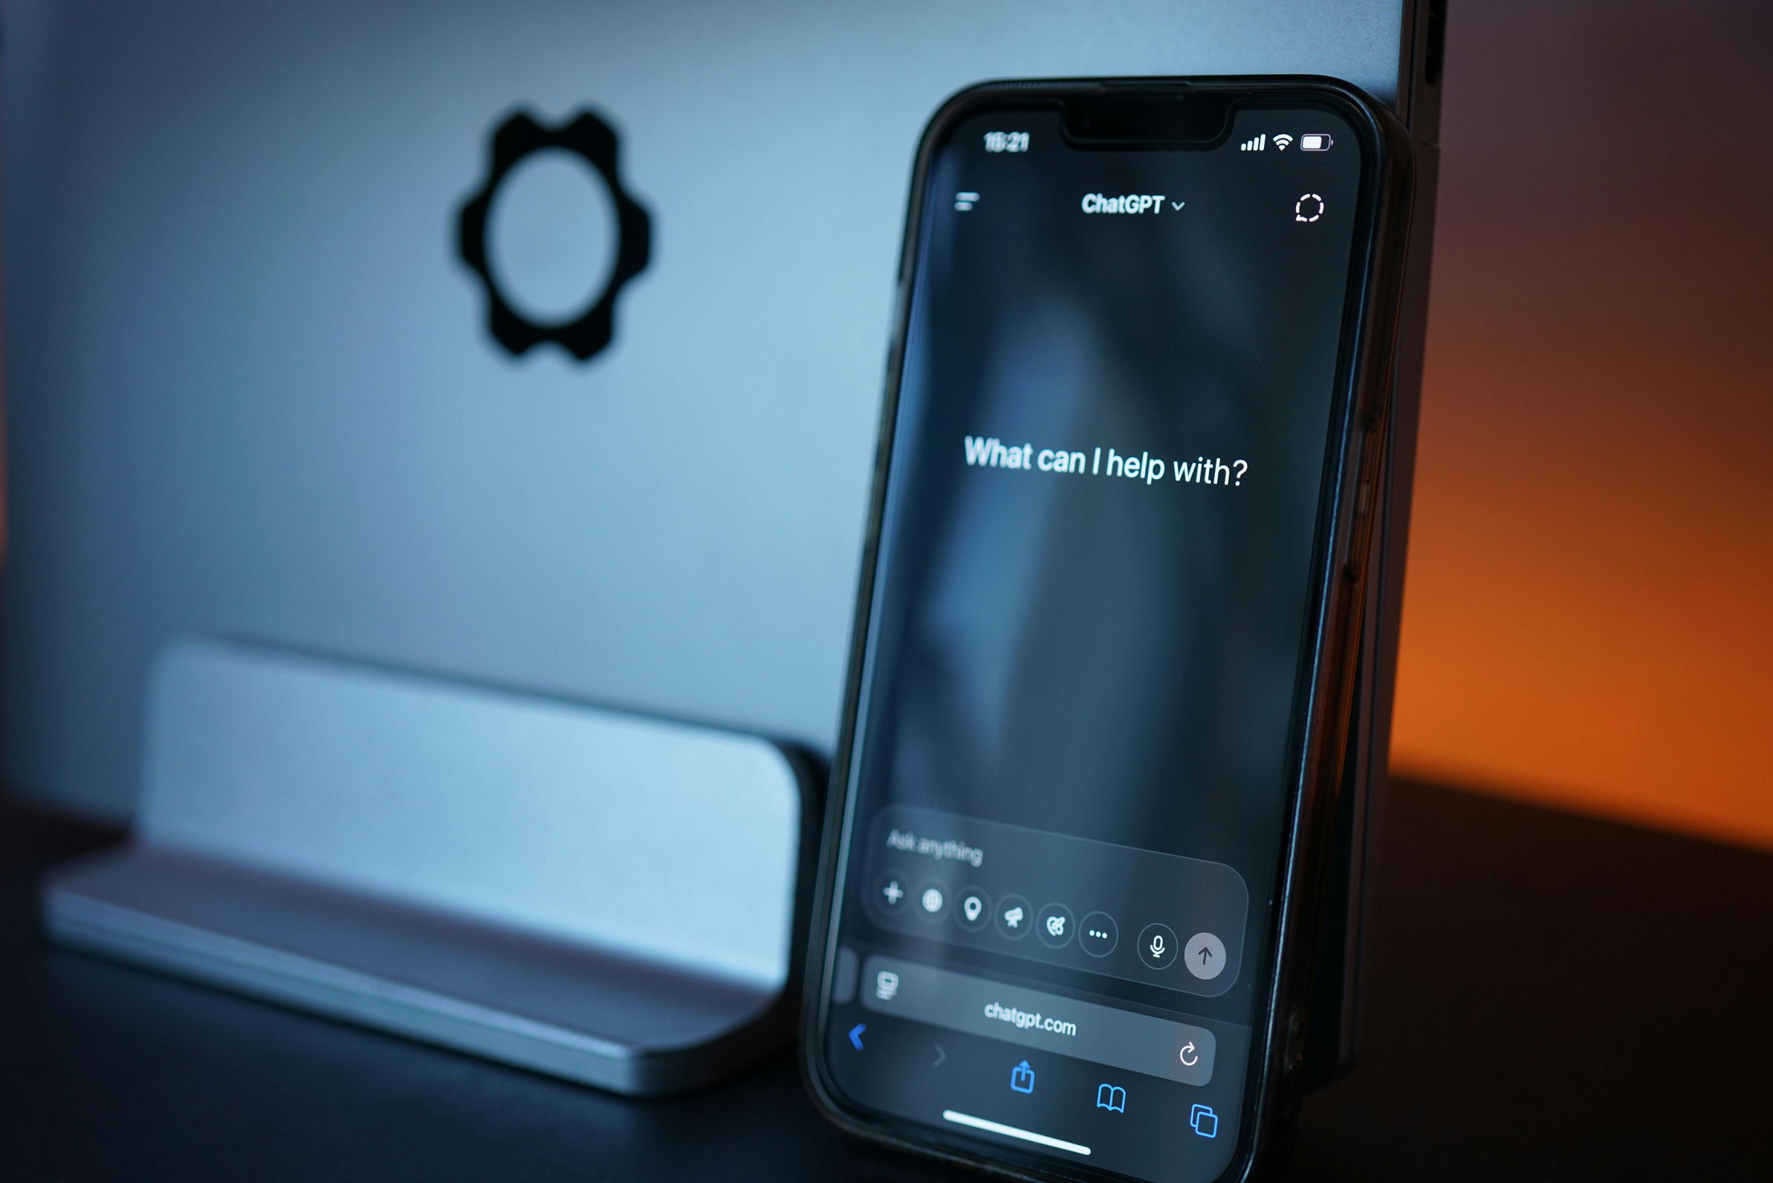
Project 2: AI Agent Prototype
The second project is called the AI Agent for Men’s Shopping.
The problem I wanted to solve here is that most shopping apps today only focus on providing product catalogs. They rarely offer real-time, personalized guidance. As a result, users often feel overwhelmed with too many options and no clear direction.
Goal was to design an AI-powered shopping agent that feels like a personal shopping companion. It listens,
understands, and responds to the user’s needs while giving meaningful styling recommendations.

Slide 8
Features
This AI Agent is designed to provide a much richer experience than a traditional shopping app.
It can listen and respond naturally to the user, just like a human stylist.
The agent accepts multiple types of inputs—a user can talk to it, type their preferences, or even upload an image for reference.
Based on these inputs, the agent suggests personalized fashion recommendations that suit the user’s style and occasion.
What makes it unique is its ability to also use gestures and body language in interactions, making the shopping experience more human-like and engaging.

Slide 9
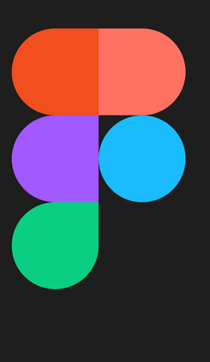
Tools and Technologies
To design and prototype this project, I used Figma, which allowed me to create the interface and user flow.
The idea for intelligence relied on AI frameworks such as Natural Language Processing (for understanding text/voice) and Computer Vision (for analyzing uploaded images).
For building the prototype quickly, I also considered no-code and low-code platforms, which can help deploy functional demos without heavy coding.

Slide 10
Demo Link
You can view this prototype on Figma using the link below:
🔗 AI Agent Prototype
This prototype demonstrates the flow of interaction between the user and the AI agent.

Slide 11



Thank You!
I am truly grateful to Sawariya Futureworks for this innovative project.
It gave me the chance to explore new tools, apply AI creatively, and learn how to design real-world, user-focused solutions.
This experience has been invaluable in shaping my skills and confidence in the AI field.
This report provides an overview of the Legal Division’s objectives, functions, and contributions to the overall strategy of the company. By addressing legal challenges proactively, the division not only protects the organization from potential risks but also supports its growth and innovation initiatives.
+91 9321457294
shuklariya434@gmail.com

